Slide 1
Conversation Recommendation System
汇报人：周红扬
汇报日期：2021.4.20

Slide 2
Contents
Background
Challenges
Dataset
Evalueation
Future Work

Slide 3
Background
1. What exactly does a user like?
2. Why does a user like an item?
Definition：
A recommendation system that can elicit the dynamic preferences of users and take actions based on their current needs through real-time multi-turn interactions using natural language.

Slide 4
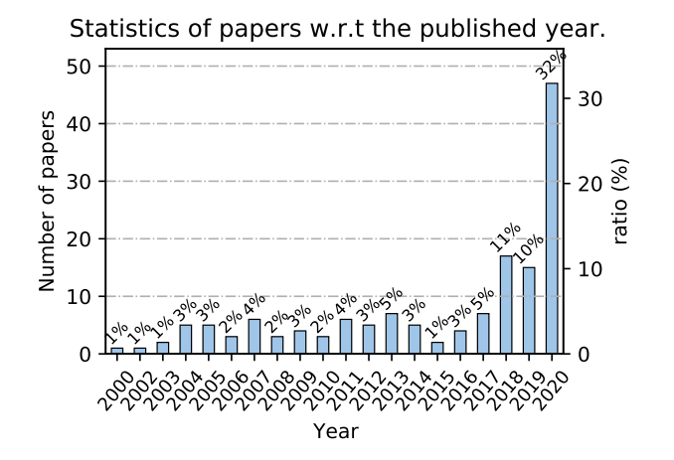
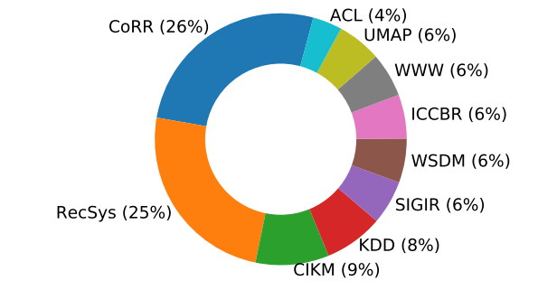
Statistics of the publications related to CRSs,grouped by the publication year and venue. Only the top 10 venues are used in the visualization.

Slide 5
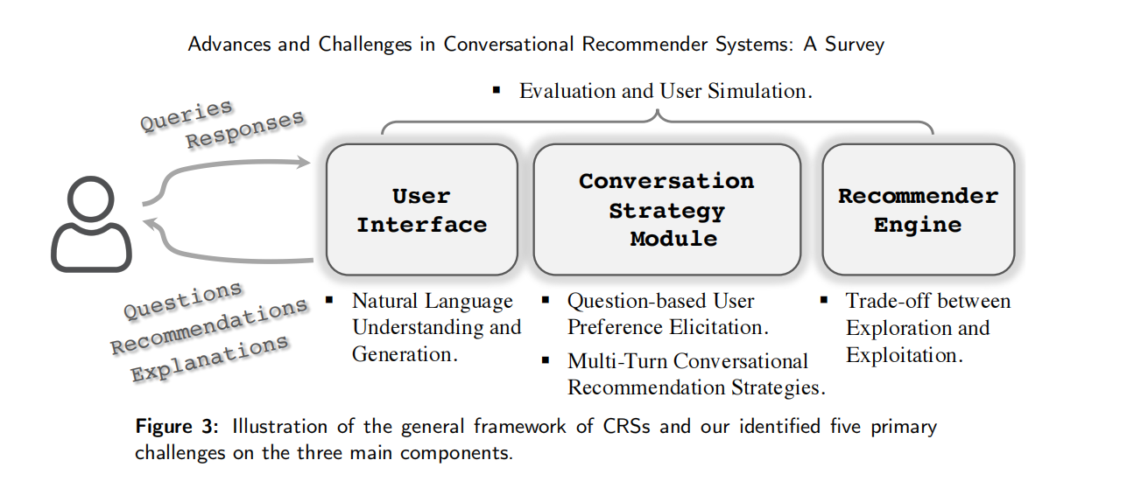
Challenges

Slide 6
Question-based User Preference Elicitation
(1) What to ask?
item /attributes categories
(2) How to adjust the recommendations based on user response?

Slide 7

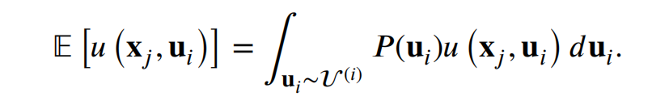
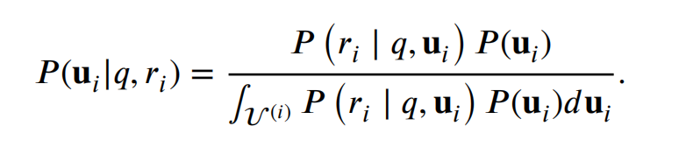

Asking about Item
Choice-based Methods
MF Vector——>average
Bayesian Preference Elicitation

Slide 8
Asking About Attributes
Fitting Patterns from Historical Interaction
GRU or LSTM+Trigger
Reducing Uncertainty
Critiquing-based Methods
CE-NCF(explainable neural network)
Graph-Constrained Candidates

Slide 9
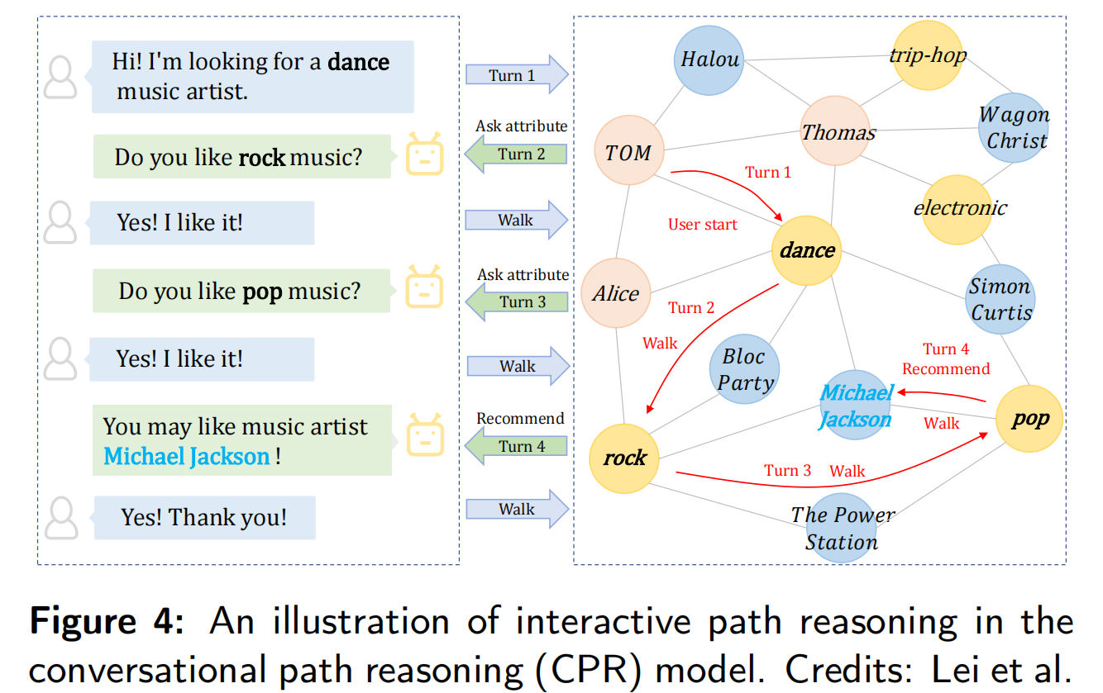

Slide 10
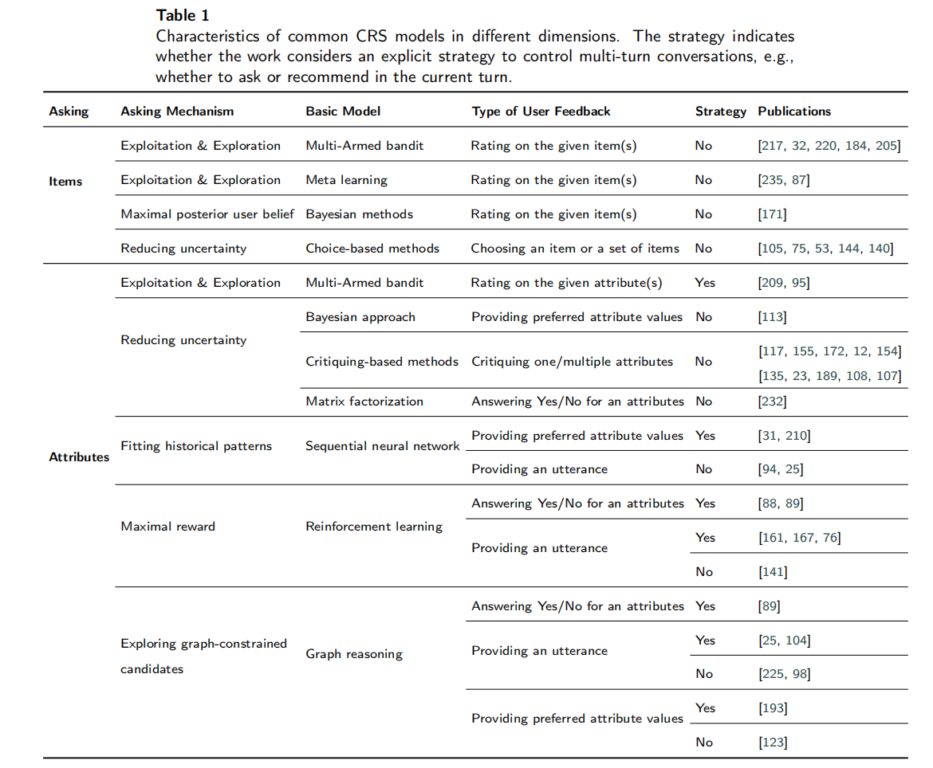

Slide 11
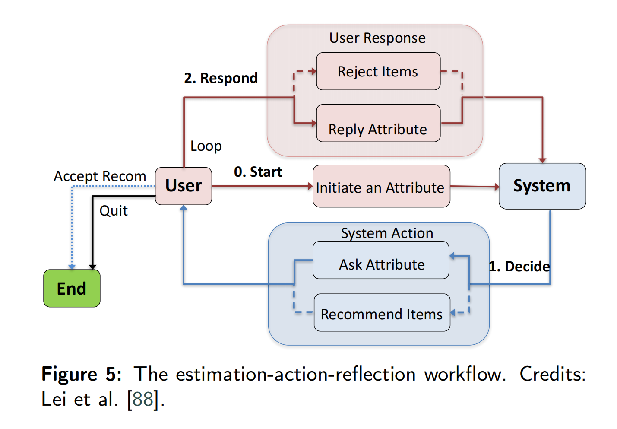
Multi-turn conversational strategies for CRS
1.when to ask and Recommend？
score/CRM (l+1)/EAR

Slide 12
Conversation strategies from A Broader Perspective
Muti-topic Learning in Conversation
how to maintain the conversation
Special Ability：Suggestion，Negotiating，Persuading
(e.g., logical appeal or emotion appeal) (personality,
morality, value systems, willingness）

Slide 13
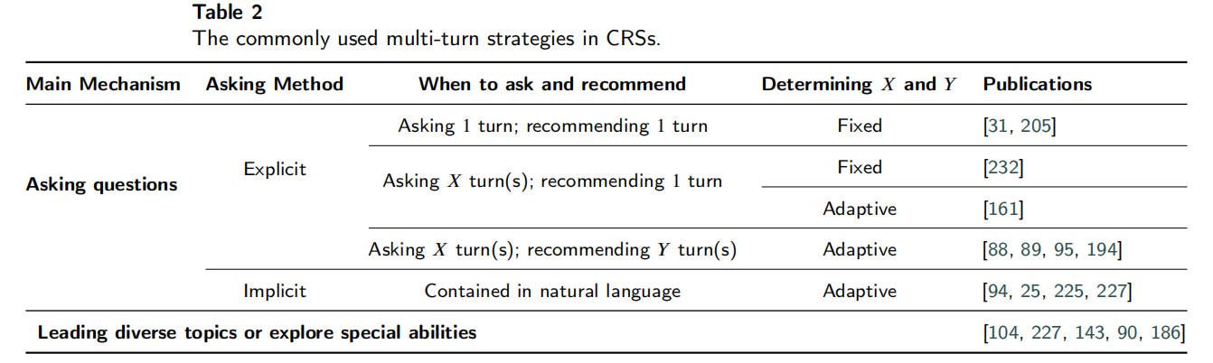

Slide 14
Dialogue Understanding and Generation in CRS
Dialogue Understanding
Slot Filling
intention and sentiment learning
Response Generation
Retrieval-based Methods
Generating Proper Utterances in Natural Language
Generation-based Methods ok/yes how to value？

Slide 15
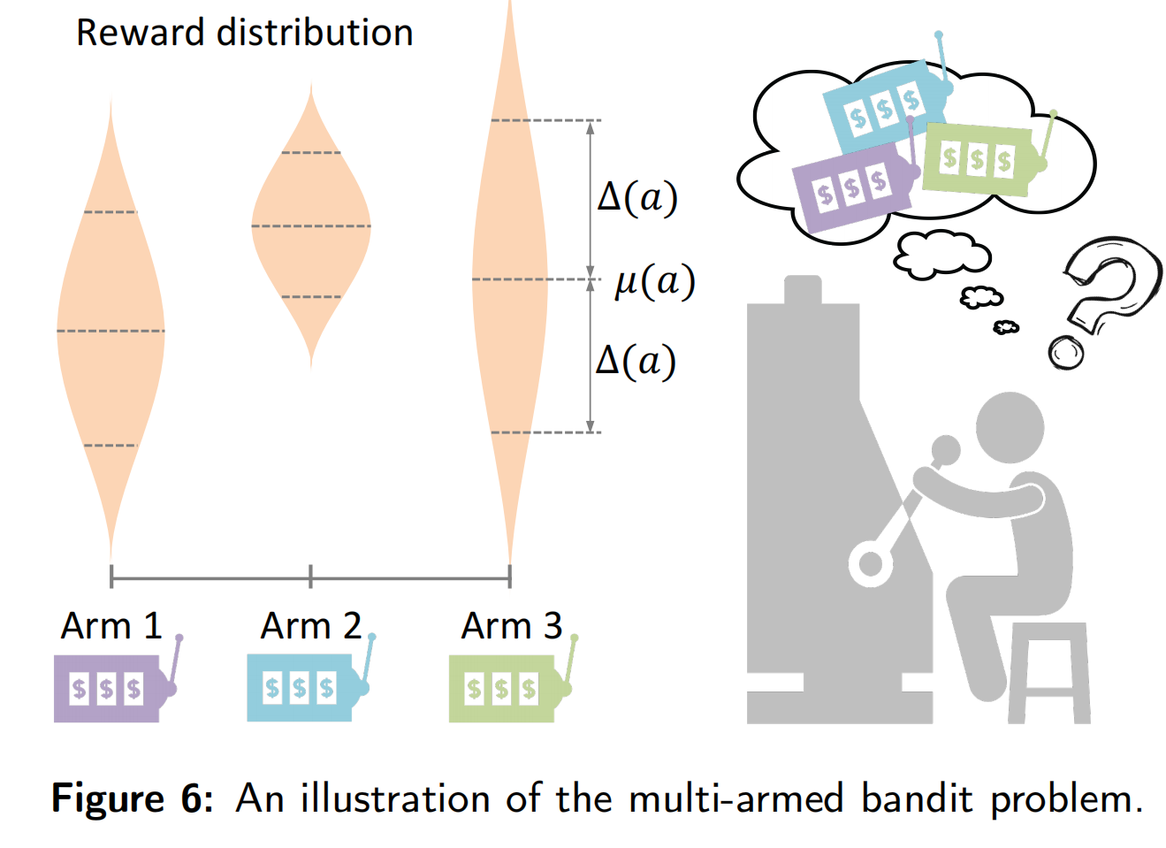
Introduction to Multi-Armed Bandits
Exploration-Exploitation Trade-offs

Slide 16
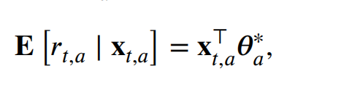
Exploration-Exploitation Trade-offs
Introduction to Multi-Armed Bandits
LinUCB
Meta Learning for CRSs

Slide 17
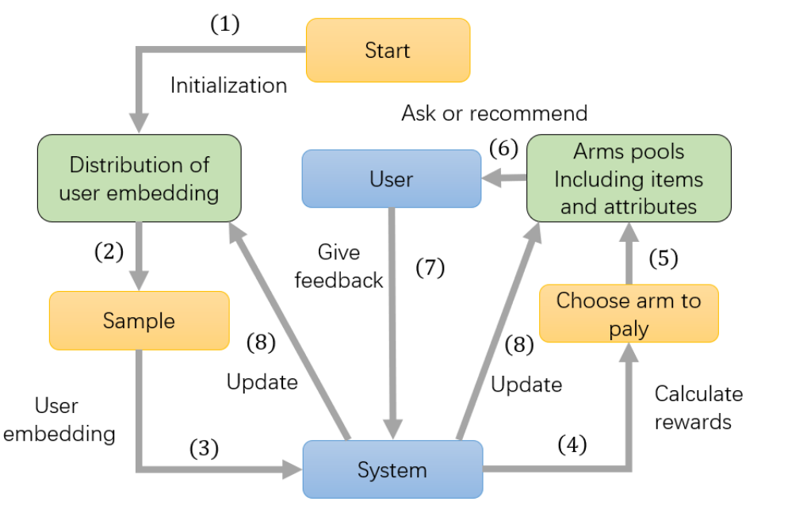
Exploration-Exploitation Trade-offs
Recommendation via MAB-based Methods

Slide 18
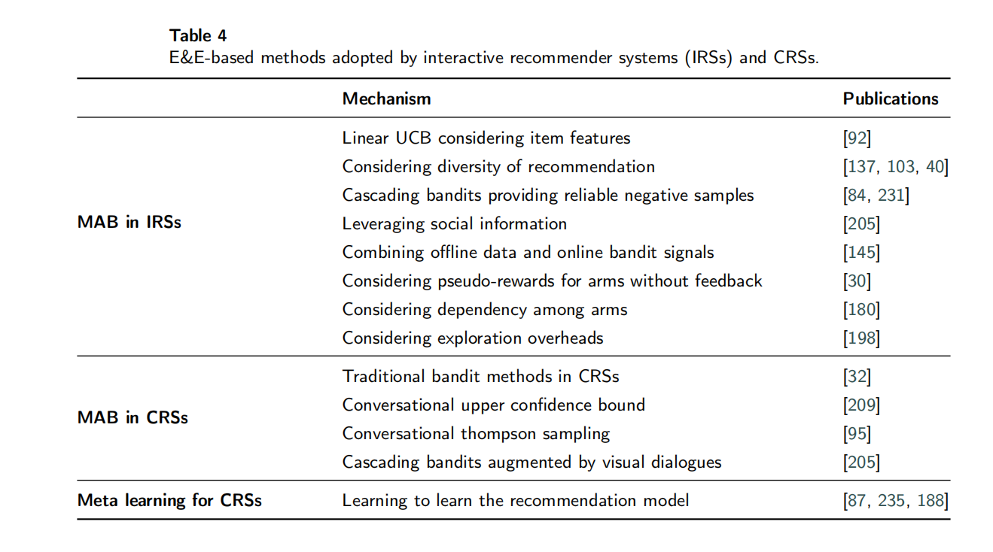

Slide 19
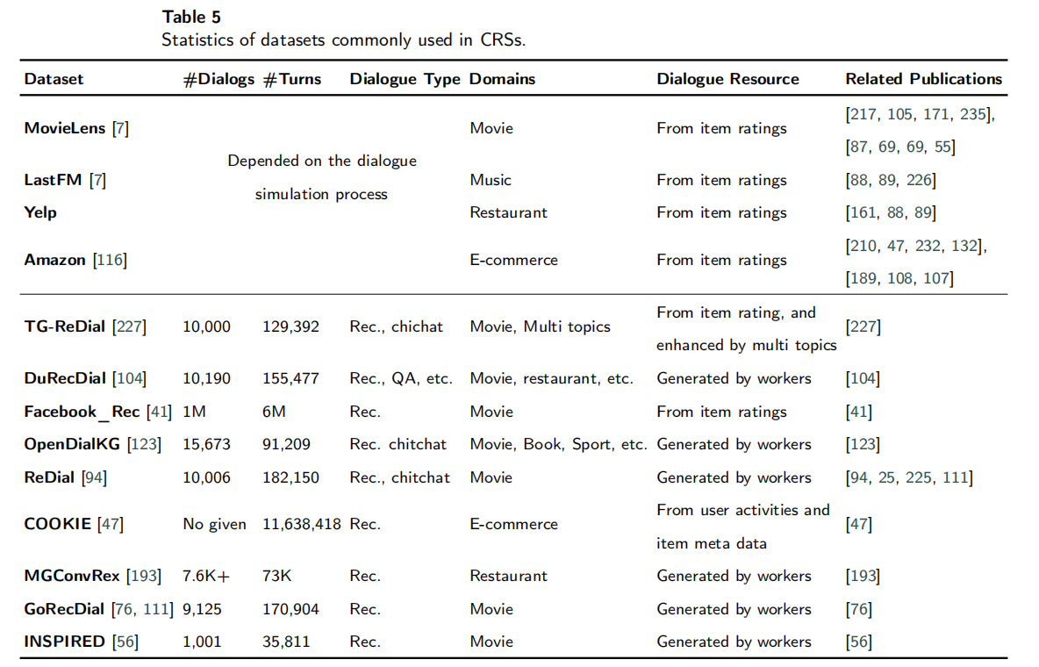
Evaluation and User Simulation
DataSet

Slide 20
Turn-level Evaluation
Evaluation of Language Generation
Evaluation of Recommendation
Rating-based Metrics(MSE\RMSE)
Ranking-based Metrics(MRR\MAP\NDCG)

Slide 21
Conversation-level Evaluation
Online User Test(AT)(SR@T)
User Simulation
Using Direct Interaction History of Users.
eg “I’m looking for <Category> in <City>”,
Extracting Information from User Reviews
Imitating Humans’ Conversational Corpora

Slide 22
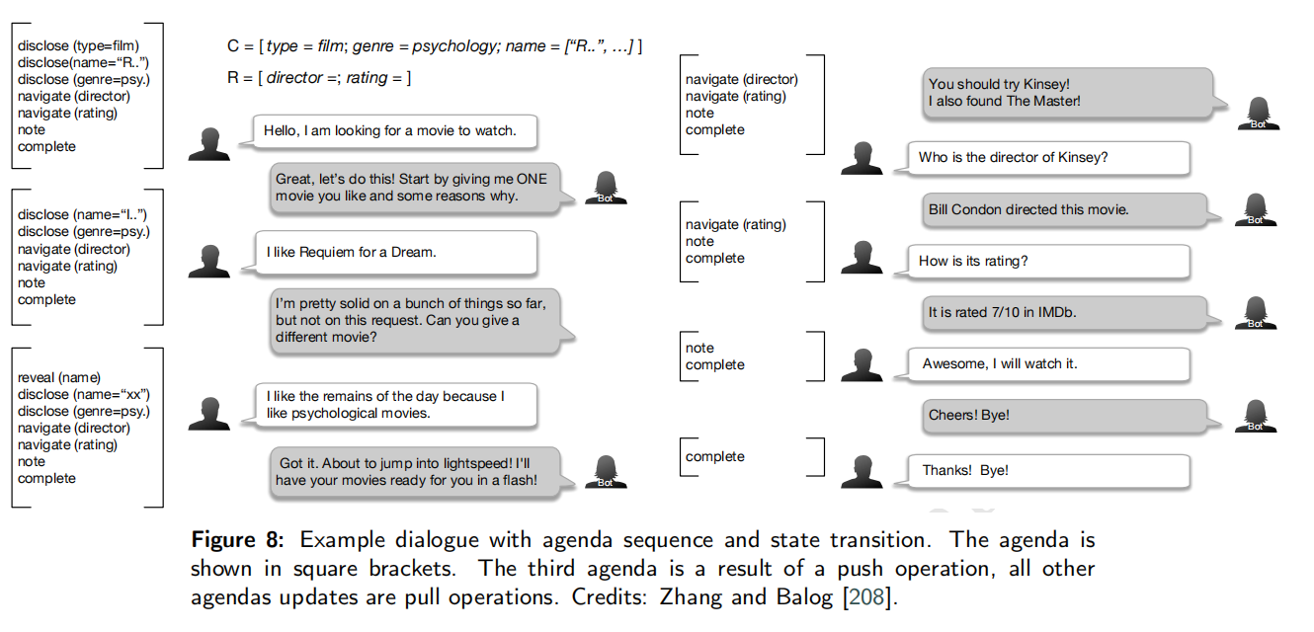
Imitating Humans’ Conversational Corpora

Slide 23
Future Directions and Opportunities
Jointly Optimizing Three Tasks
Bias and Debiasing
sophisticated Multi-turn Conversation Strategies
knowledge enrichment
better Evaluation and User simulation

Slide 24
Thanks

